Slide 1
Task 2: Defining time in an energy model
In Canvas, you can download ‘VT20L2_TimeRepresentation_EX2.xlsx’ which will be used for this task.
This file has 4 sheets/tabs: Yearly_load, Hourly_load, Year_Split and Demand_Profile.
In the following slides you will be given the instructions that you will need to follow and implement in the ‘VT20L2_TimeRepresentation_EX2.xlsx’.
The filled in excel file will be another part of individual assignment PRO2 (more to come in lab 3).

Slide 2
Task 2: Defining time in an energy model
Step1. Based on the ‘Average monthly load’ data given in the ‘Yearly_load’ tab (slide 40), determine an appropriate number of Seasons.
Step2. Determine which months are part of each season.
Month | Jan | Feb | Mar | Apr | May | Jun | Jul | Aug | Sep | Oct | Nov | Dec
MW | 598 | 553 | 464 | 431 | 510 | 550 | 785 | 725 | 663 | 484 | 456 | 536
# of days | 31 | 28 | 31 | 30 | 31 | 30 | 31 | 31 | 30 | 31 | 30 | 31

Slide 3
Task 2: Defining time in an energy model
Step3. Based on 1 and 2, calculate the number of days in each season, as per the example on the table to the right.
Write your answer in Table 1.
Seasons | Months in each season | Days in each season
Season 1 | i.e Jan - Feb | 31 + 28 = 59
Season 2
…..
…..

Slide 4
Task 2: Defining time in an energy model
Step 4. Assume that the load during week days and weekends is the same. Which means you have one day type.
Step5. From the tables given in the ‘hourly_load’, determine the appropriate number of Day Parts (i.e day load/peak load..etc).
Step6. Calculate the number of hours for each Day Parts. i.e: Day Part 1 = 8.00 am – 11.00 am (3 hrs)
Write your answers in Table 2.
Days Parts | Day Part 1 (i.e work hrs) | Day Part 2 (i.e ….) | Day Part 3 (i.e ….) | …
Duration | 08:00-11:00 |  |  | …
# of hours | 3 |  |  | …

Slide 5
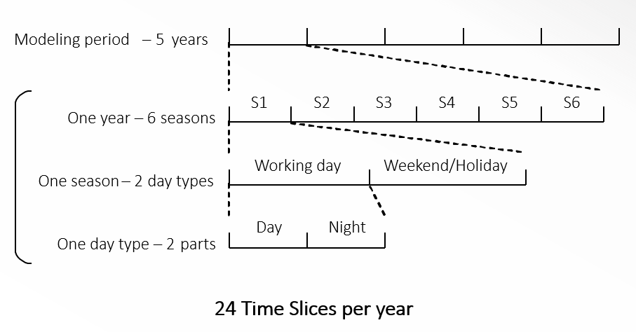
Task 2: Defining time in an energy model
Step7. By now, you have developed the model time slices. Merge tables 1 and 2 and write your results in table 3 given in ‘Year Split’ tab.
Step7. Calculate the duration of each time slice (to the total hours in the year) and fill in the values in table4: in the `Year_Split` tab.
The sum of each entry over one modelled year should equal 1.
We will call this value Year Split.
Remember that:
TimeSlices = Seasons * DayTypes * DayParts

Slide 6
Task 2: Defining time in an energy model
So far we have calculated the number of time slices, the duration of each TS and fraction of each TS to total number of hours in one year.
Now we need to determine the annual fraction of energy demand that is required in each time slice.
Step8. Following a similar approach, think how to calculate the Specified Demand Profile. You have the hourly load and you have already developed the time slices.
Write your results in table 5 in the ‘Demad_Profile’ tab.
Notes:
Year Split: is the duration of a modelled time slice, expressed as a fraction of the year. The sum of each entry over one modelled year should equal 1.
Specified Demand Profile: Annual fraction of energy-service or commodity demand that is required in each time slice. For each year, all the defined SpecifiedDemandProfile input values should sum up to 1.

